Slide 1
How to find the best place to live (France)
Julien
Oct 19.

Slide 2
Introduction
Hello, my name is Julien. I’m living in Paris and I will probably move to Lyon in the next years. Therefore, I need to create a tool to choose carefully where I want to live (because Lyon is the 2nd biggest city in France, and there are many cities/neighborhoods around Lyon).
I will then create a tool for decision making. The final customer will be me in this case, but we can standardize the tool in order to help other people.
I will focus my studied location to Chassieu city (and I will suppose that my work is located there). It’s a small city in the Est suburb of Lyon.
Interest: A real estate company would love my tool to help people choose where they ideally can live! That will help people to imagine their life in this new house and to buy it!

Slide 3

Data set
1. First, I will use an online file with information about cities in France: City Code, longitude, latitude, Name of the city, etc...
With it, I will be able to refine this list to cities which are less than 25km away than Chassieu.
Link: https://public.opendatasoft.com/explore/dataset/code-insee-postaux-geoflar/export/?flg=fr
2. I will use google API to get the time of travel between cities, therefore I created a google developer account and use Matrix distance API (which can give the time in car between 2 locations).
I will refine my study to cities which are 25 min away from Chassieu (in car).
3. I will use a geojson file of cities in France to create a choropleth map and then plot cities with color regarding the time of travel from Chassieu.
Link: https://github.com/gregoiredavid/france-geojson
4. I will also use foursquare to get venues in these cities, in order to cluster (same analysis than NYC lab, but with some modifications to fit to my data).

Slide 4
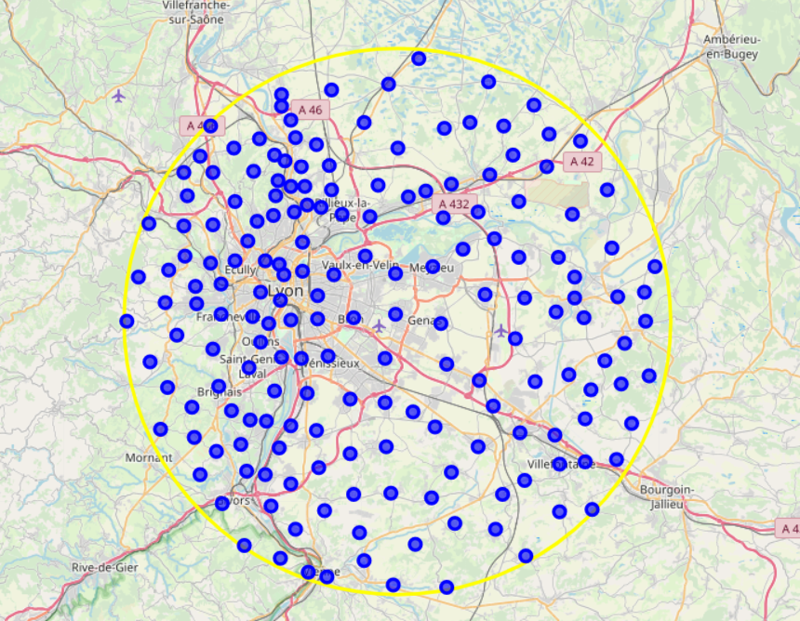
Cities in a 25km range from Chassieu
190 Cities in a 25km range from Chassieu

Slide 5
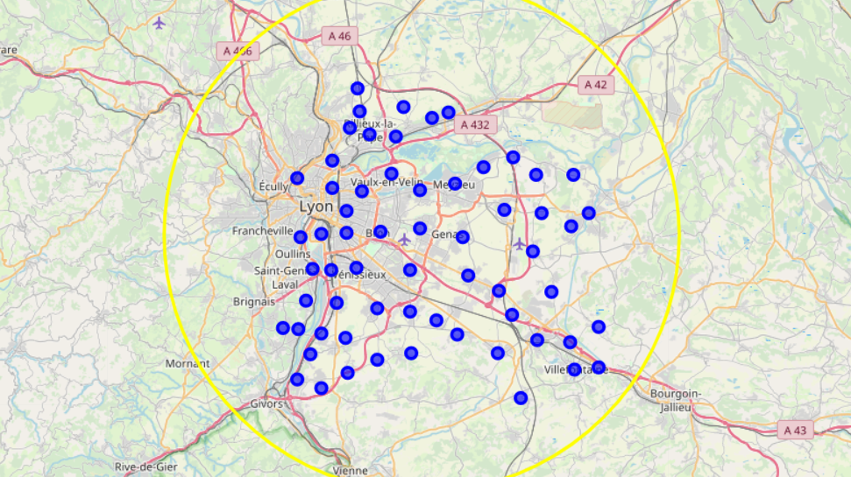
Cities in a 25 min range from Chassieu – 62 cities !

Slide 6
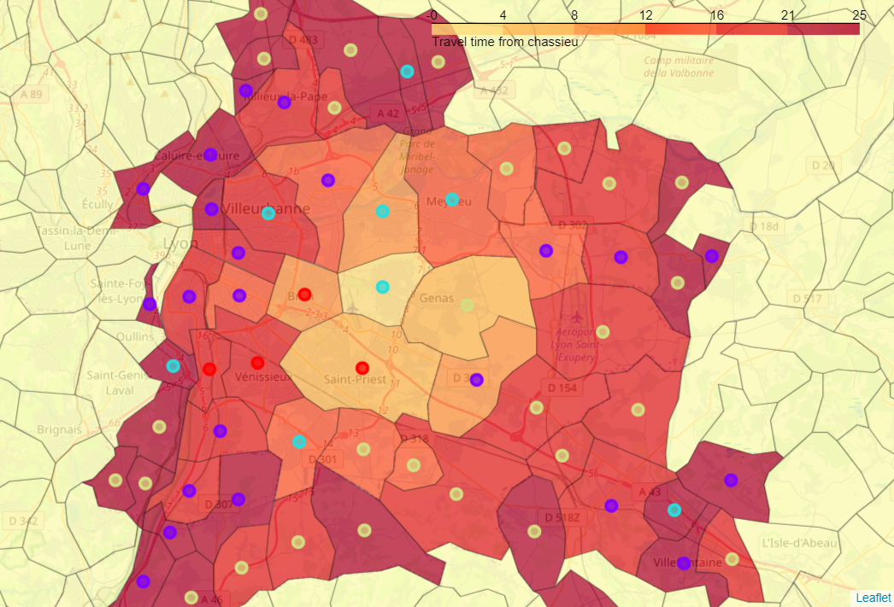
Grouping these 62 cities in 4 clusters
Yellow cluster: Villages / Countryside
Purple cluster: City center
Light blue cluster: Suburb without public transport
Red cluster: Suburb with lot of public transports

Slide 7
Conclusion
In conclusion, this analysis is giving us the possibilies of location to explore. I’m not really sure of which cluster we will choose.
On the first hand, countryside has big avantages, like having a house, for a lower price. But it’s also a long travel to work... On the other, commodities from the 2 suburb clusters are appreciable. But it will be more expensive!
What is sure is that I will look at the choropleth map of travel time closely because I want to minimize travel time to work.

